Slide 1
Angie Rosen
Director of Curriculum and Instruction
Little Silver School District
Notes:
Angie Will introduce the framework by handing out books and giving participants an overview of our past training and introduction of DEAC committee.

Slide 2
Teacher Evaluation Model
meet

Slide 3
The Wisdom of Practice
Notes:
Activity: have teachers write 4 to 6 things on post its and put them up on chart
Debrief

Slide 4
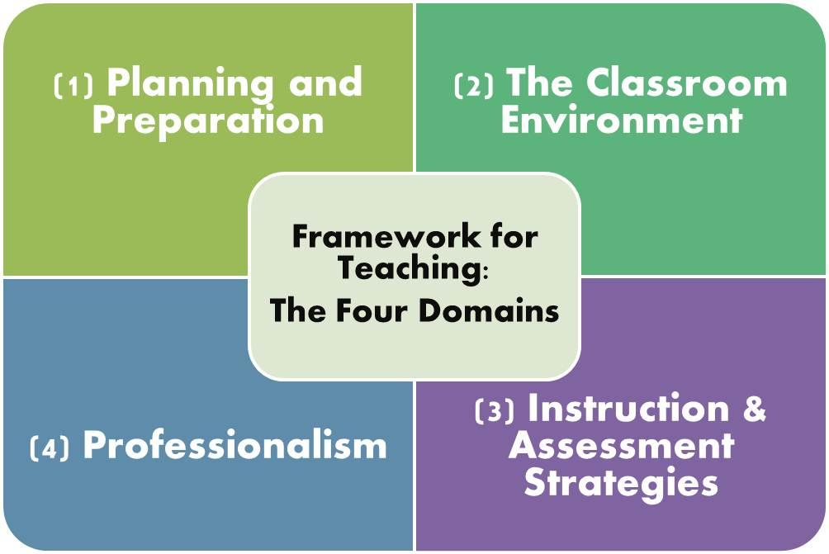

Slide 5
Essential Elements of Educating

Slide 6
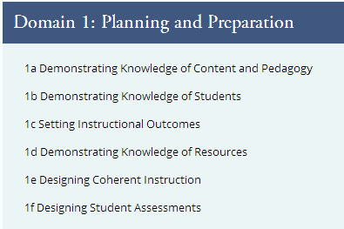
Failing to Plan is Planning to Fail
What might be evidence of each of the components?
Discuss the critical attributes you think would fall under each of the components.
Notes:
Provide a handout with examples of critical attributes for each of the components under the 4 domains. Discuss how a developing attribute might become an effective one or a highly effective one. Access the bookmark pages.
CRITICAL ATTRIBUTES
• The teacher cites intra- and interdisciplinary
content relationships.
• The teacher’s plans demonstrate awareness of
possible student misconceptions and how they
can be addressed.
• The teacher’s plans reflect recent developments
in content-related pedagogy.

Slide 7
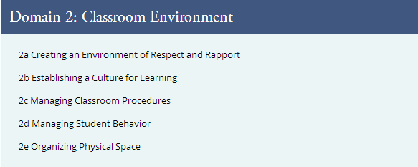
Classroom Environment
What might be evidence of each of the components?
Discuss the critical attributes you think would fall under each of the components.
Notes:
CRITICAL ATTRIBUTES
• The teacher demonstrates knowledge and caring
about individual students’ lives beyond the class
and school.
• There is no disrespectful behavior among students.
• When necessary, students respectfully correct one
another.
• Students participate without fear of put-downs or
ridicule from either the teacher or other students.
• The teacher respects and encourages students’
efforts.

Slide 8
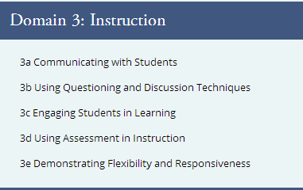
Instruction
What might be evidence of each of the components?
Discuss the critical attributes you think would fall under each of the components.

Slide 9
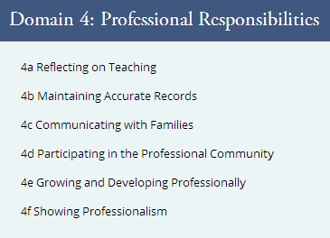
Professional Responsibilities
What might be evidence of each of the components?
Discuss the critical attributes you think would fall under each of the components.

Slide 10
Key components
1c- Setting Instructional Outcomes
2b- Establishing a Culture for Learning
3c- Engaging Student Learners
4a- Reflecting on Teaching

Slide 14
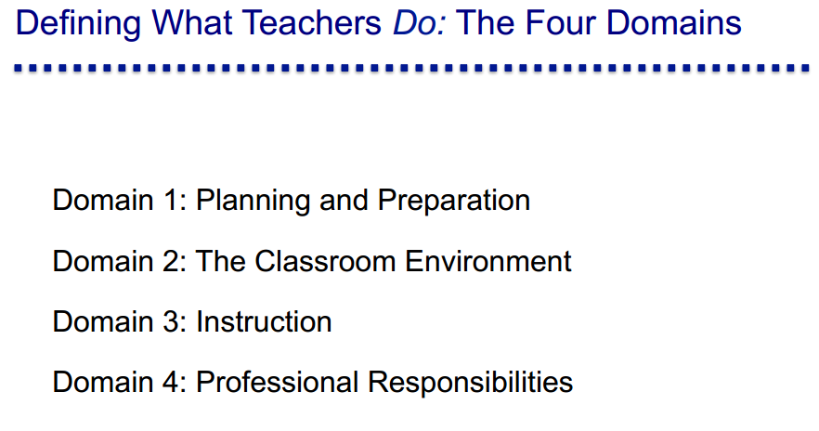

Slide 16
Expectations for All
How will the framework support my teaching?
What can I expect from each of the observation opportunities?

Slide 17
Challenge…

