Slide 1

Accommodations and Modifications 101
By: Christie M. Robinson, Ed.D

Slide 2
Accommodations/Modifications
Review Terms & Concepts:
Accommodations
Modifications
Instruction/Effective Instruction

Slide 3

Legal Justification
Accommodate, Modify, and Support
I.D.E.A. Reauthorization specifies (300.342(b)(3)) that the public agency shall ensure... each teacher and provider is informed of his or her specific responsibilities related to implementing the child’s IEP and the specific accommodations, modifications, and supports that must be provided for the child in accordance with the IEP.
N.J.A.C. 6A:14-4.3(a)1 Program Options: all students shall be considered for placement in the general education class with supplementary aids and services including, but not limited to, curricular or instructional modifications or specialized instructional strategies

Slide 4
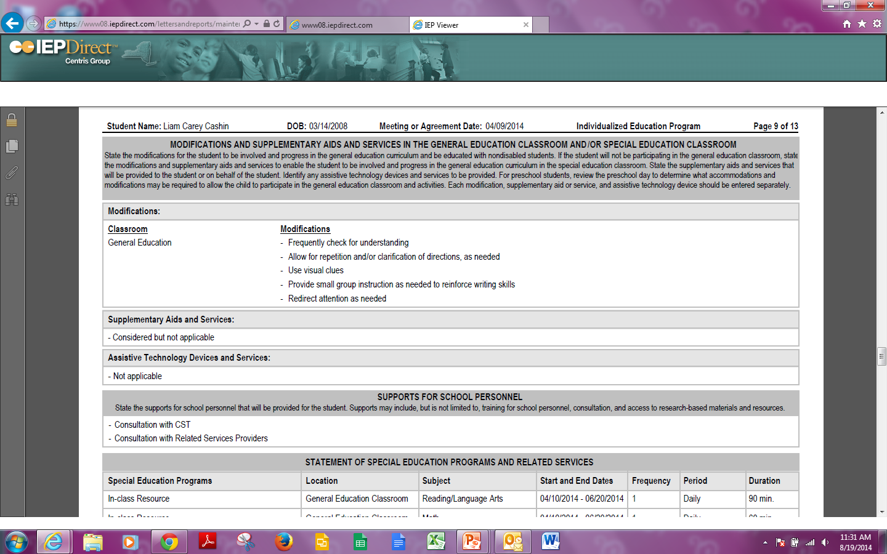
Location, Location, Location

Slide 5
Adaptations
Accommodations
Modifications
Do not fundamentally alter or lower
expectations or standards in instructional
level, content or performance criteria.
Do fundamentally alter
or lower expectations or
standards in instructional level,
content or performance criteria.
Changes are made in order to provide equal
access to learning and equal opportunity to
demonstrate what is known.
Changes are made to provide
student meaningful &
productive learning experiences
based on individual needs &
abilities.
Grading is same
Grading is different

Slide 6
What is accommodated?
The Characteristics of the Learner
Goal: To remove barriers to learning the material and to demonstrating mastery
↓ Standards are substantially the same for all; outcomes will vary.
1-3

Slide 7
Learning Differences
Speed of information processing
Memory: Encoding, Storage, Retrieval
Automatization of rote facts
Organization
Listening Skills
Attention
Forethought and Planning
Etc.

Slide 8
Emotional/Temperament Characteristics
Rigidity/Flexibility
Irritability
Placidity
Social Awareness
Desire for Novel vs. Familiar
Anxiety
Etc.

Slide 9
Reading/Writing/Math Skill Deficits
Reading Decoding vs. Understanding
Math Fact Recall vs. Math Concepts
Writing Mechanics vs. Written Content
Etc.

Slide 10
Cognitive/Conceptual Skill Differences
Processing speed
Conceptualization
Understanding of Elapsed Time
Inferential Thinking
Conservation, Multiple Variable reasoning
Etc.

Slide 11
Sensory Input Challenges
Vision
Hearing
Movement

Slide 12
What is modified with modifications?
The Goal of the Activity
Goal: To allow educational progress in mastering curriculum, physical and social access to a full array of IEP team determined appropriate classrooms and peers.
Individualized goals are developed, skills taught and measured through either standard assessments with modifications (mild disabilities) or through alternate assessments (moderate to severe disabilities).

Slide 14
Nine Types of Curriculum Adaptations
Quantity * •
Adapt the number of items that the learner is expected to learn or number of activities student will complete prior to assessment for mastery.
For example:
Reduce the number of social studies terms a learner must learn at any one time. Add more practice activities or worksheets prior to assessment of skill mastery.

Slide 15

Ponder This
  Does altering amount of seatwork completed prior to assessment of content mastery constitute a modification or an accommodation?
    If I reduce practice, and now
    student can’t demonstrate
    mastery?
    If I reduce practice and
  student can still demonstrate
  mastery?

Slide 16
Nine Types of Curriculum Adaptations
Time *
Adapt the time allotted and allowed for learning, task completion, or testing.
For example:
Individualize a timeline for completing a task; pace learning differently (increase or decrease) for some learners.

Slide 17
Ponder This
  Does giving more time to complete an assignment or take a test result in a lowering of a standard?
  How should this be graded or evaluated?
  Is this practice a modification or an accommodation?
  Discuss at your table

Slide 18
Nine Types of Curriculum Adaptations
Level of Support *
Increase the amount of personal assistance to keep the student on task or to reinforce or prompt use of specific skills. Enhance adult-student relationship; use physical space and environmental structure.
For example:
Assign peer buddies, teaching assistants, peer tutors, or cross-age tutors. Specify how to interact with the student or how to structure the environment.

Slide 19
Ponder This
  Is this a common practice?
  Do students without disabilities often have this support?
  Do we use this too frequently or
  too little?
  Is this an accommodation?
  If so, for what?
  Are we using one on one paraeducators effectively?

Slide 20
Nine Types of Curriculum Adaptations
Input *
Adapt the way instruction is delivered to the learner.
For example:
Use different visual aids, enlarge text, plan more concrete examples, provide hands-on activities, place students in cooperative groups, pre-teach key concepts or terms before the lesson.

Slide 21
Ponder This
  Discuss at your table
  Is Input an accommodation or
  modification?
  What is more effective: pre-teaching
  or re-teaching?

Slide 22
IN
Input Enhancement
Use strategies and scaffolds
  To accommodate diverse learners.
Accommodation during INPUT
  A service or support to help fully access the subject matter and instruction.

Slide 23
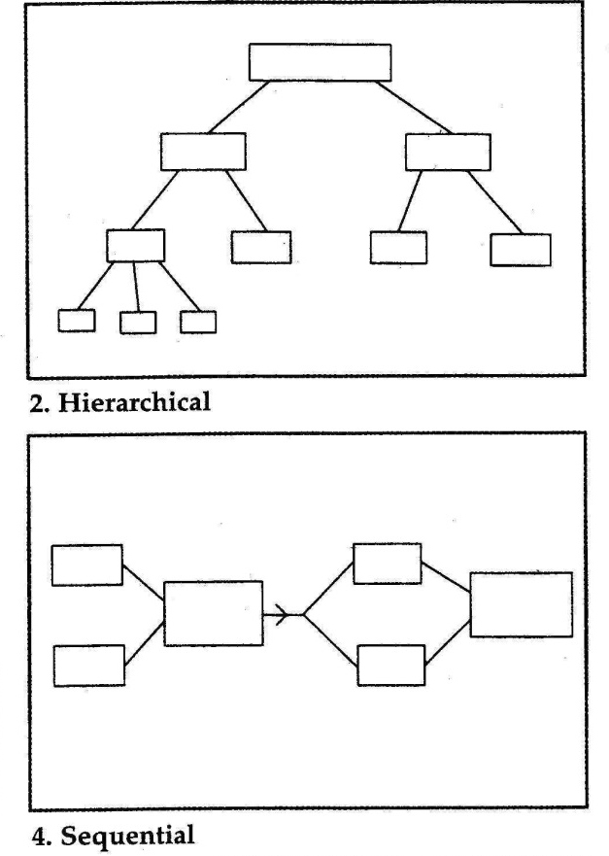
IN
Input Enhancement
Using graphic organizers when teaching content…
Organization of ideas is self-evident to students.
Reduces information processing demands needed to understand new information.

Slide 24
INPUT: Visual Displays
Portray relationships among information presented in instruction
Includes diagrams, concrete
models, concept maps, videos
situating learning in a meaningful context,
or digital material presented during instruction.
Intended to help students organize information in long-term memory.

Slide 25

Visual Displays
Activate prior knowledge during instruction.
Function as an accommodation when they scaffold the creation of linkages among information in the learner’s long-term memory.

Slide 26
INPUT: Pre-teaching with Advance Organizers
Defined: Pre-instructional materials to aid linkage of new information with prior knowledge stored in long-term memory.
  May be verbal, written, or be presented in a question format. Examples:
    Questions presented prior to a discussion or reading assignment.
    Vocabulary words presented on the board or a handout.
    Verbal statements by the teacher designed to activate knowledge prior to instruction.

Slide 27

Peer-Mediated Instruction
Defined—students as instructional
agents, including:
Peer and cross-age tutoring.
Class-wide tutoring.
Cooperative learning.
Primary purpose—increase opportunities for distributed practice with feedback.
Usually has well-scripted or structured interactions designed and mediated by the teacher.
Nolet (2000)

Slide 28
Study Guides
Worksheets prior to a reading or study assignment.
Includes a set of statements or questions to focus the student’s attention and cognitive resources on key information to be learned. Examples:
  Completed or partially completed outlines.
  Questions focusing on the textual, literal, and inferential aspects of a study assignment.
  Other tasks designed to prompt the active processing of the material to be studied.

Slide 29
Mnemonic Devices-
For Content Domains
Defined: Techniques to aid storage
& recall of declarative knowledge
May be verbal or pictorial.
May be provided by the teacher
or developed collaboratively by
teacher and the student.
Can be key words, pictures or symbols—
e.g., Every Good Boy Deserves Fudge.

Slide 30


Input Accommodations
IN
Are Foundational Interventions:
The key to differentiated instruction:
Use guided practice, strategies and scaffolds
They accommodates diverse learners

Slide 31
Nine Types of Curriculum Adaptations
Difficulty * •
Adapt the skill level, problem type, or the rules on how the learner may approach the work.
For example:
Allow the use of a calculator to figure math problems; simplify task directions; change rules to accommodate learner needs.

Slide 32
Ponder This
  Discuss.
  Is altering the difficulty of an assignment a good practice?
  When is it an accommodation or
  a modification?

Slide 33
Nine Types of Curriculum Adaptations
Output *
Adapt how the student can respond to instruction.
For example:
Instead of answering questions in writing, allow a verbal response, use a communication book for some students, allow students to show knowledge with hands on materials.

Slide 34
Output Accommodations
OUT
Altered methods of demonstrating mastery of the instruction.
Measures what the student learned, not the student’s disability or characteristics.
Removes barriers.

Slide 35
Output Goal
Accommodation during OUTPUT
  A service or support to help the learner validly demonstrate knowledge, removing the characteristic or
  disability interfering with
  demonstration of what has
  been learned.
OUT

Slide 36
Output Accommodations
    Samples:
    Multiple choice vs. essay.
    Dictating vs. writing.
    Typing vs. handwriting.
    Demonstrating vs. writing.
    Timed quizzes vs. un-timed ones.
OUT

Slide 37
Output-comparisons
      Standard Accommodations
      vs. Non-standard Accommodations
    Test publishers’ language as to whether what is being measured has been altered beyond the ability to compare this student’s performance to his/her peers.
      Accommodations vs. Modifications
    Educators language as to whether what is being taught and measured is substantially altered from what is expected: The grade level standards.
OUT

Slide 38
Ponder This
  Do I alter the grading if I have altered the output method?
  Is this an accommodation or a modification?
  Do not continue to measure a known skill deficit; measure attainment of content.

Slide 39
Review: Input & Output
Accommodations
IN
  Input accommodation.
  - a service or support to help fully access the subject matter and instruction.
  Output accommodation.
- a service or support to help validly demonstrate knowledge.
OUT

Slide 40
In a Nutshell:
The most critical components of “Effective Instruction” and “Accommodation Planning”
Input Accommodation Strategy: Circumvent learner characteristic barriers: Alter presentation of information to the student.
Output Accommodation Strategy: Circumvent learner characteristic barriers: Alter production from the student.

Slide 41
In a Nutshell: Students with IEPs
Are entitled to removal of barriers to accessing and progressing in core/general curriculum
If an accommodation is on the IEP to level the playing field/remove the barrier, even if it is defined as a modification on a high stakes test, the student is entitled to that modification if necessary, regardless of the effects on “aggregating data.”
To do otherwise would be discriminatory.

Slide 42
Nine Types of Curriculum Adaptations
Participation *
Sometimes called “engagement”
Adapt the extent to which a learner is actively involved in the task.
For example:
During instruction, using “every pupil response techniques” or “choral responding.” In geography, have a student hold the globe, while others point out locations. Ask the student to lead a group. Have the student turn the pages while sitting on your lap (kindergarten).

Slide 43
Participation Enhancement to Increase Student Engagement
1. Choral responses (answers are short/same)
- Students cue you they are attending
(“eyes on me”).
- Provide thinking time.
- Signal group response.
2. Every pupil response techniques (answers are short/different)
- Student answers with gestures or answer card.
3. Partner Responses (answers long/different)
- Teacher assigns - provide a label/role “1’s tell 2’s.”
- Alternate ranking for partnering.
- Specific topics/jobs; no one is passive.

Slide 44
Participation/Enhancement
4. Written responses
- List first, then share.
- Touch something — “put your finger on the ______.”
Individual responses (AFTER practice on the new skill)
- Randomly call on individuals to share.

Slide 45
Participation AND
INPUT
IN
Differentiating during whole class instruction options include:
  Graphic organizers
  - Visual thinking — vary the
support (e.g., partially filled out,
partner dialogue).
  Projects — individual & small group
- Key is organization/structure
~ rubrics ~ touch points along the way.

Slide 46
Peer-Mediated Instruction
Defined—Students as instructional
agents, including:
Peer and cross-age tutoring.
Class-wide tutoring.
Cooperative learning.
Primary purpose—increase opportunities for distributed practice with feedback.
Usually has well-scripted or structured interactions designed and mediated by the teacher.

Slide 47
IN
Input & Participation
Enhancement
Weaker reader prompts stronger reader to:
1. Name the Who or What.
* identification
2. Tell the most important thing(s) about the Who or What.
* elaboration
3. Paraphrase in 10 words or less
(paraphrasing “straight jacket”)
* consolidation
* continues for 5 minutes —
then switch roles (new text)

Slide 48
Nine Types of Curriculum Adaptations
Alternate Goals •
Adapt the goals or outcome expectations while using the same materials. When routinely utilized, this is only for students with moderate to severe disabilities.
For example:
In a social studies lesson, expect a student to be able to locate the colors of the states on a map, while other students learn to locate each state and name the capital.

Slide 49
Nine Types of Curriculum Adaptations
Functional Curriculum •
Provide different instruction and materials to meet a learner’s functional/life skills individual goals. When routinely utilized, this is only for students with moderate to severe disabilities.
For example:
During a language lesson a student is learning toileting skills with an aide.

Slide 50
Ponder This
  Discuss.
  For whom is this adaptation appropriate?
  Why would we do this in
  the era of high standards?

